Slide 1
Microservices with Kafka
Know Your Products and Technology
Tarun Poddar

Slide 2
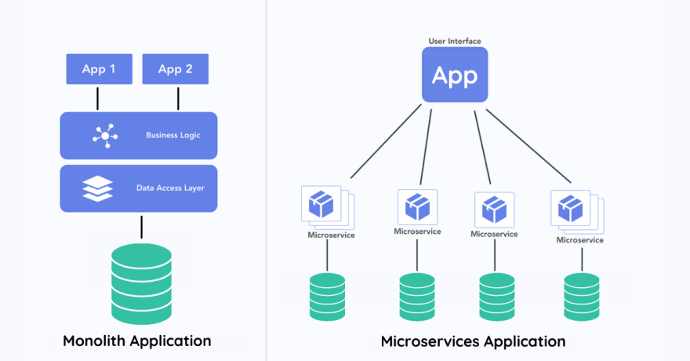
Microservices
Scalability, resilience, and agility.
Seamless communication between microservices requires robust messaging systems.
Kafka solves the purpose.
Notes:
In today's world of distributed systems, microservices architecture has gained significant traction due to its scalability, resilience, and agility. ​
API management issue
Central to this architecture is the seamless communication between microservices, which often requires robust messaging systems.​
One such powerful tool is Kafka, particularly the Confluent Kafka platform, which offers a comprehensive ecosystem for building real-time data pipelines and streaming applications.​

Slide 3
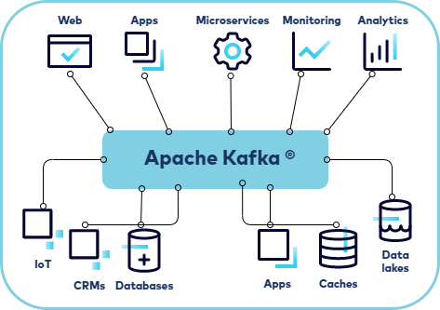

What is Kafka?
Apache Kafka is an open-source distributed event streaming platform originally developed by LinkedIn and now maintained by the Apache Software Foundation.
Kafka is designed for high-throughput, low-latency, scalable, and durable messaging.

Slide 4
Where is Kafka used?
LinkedIn
Netflix
Uber
Spotify
Twitter
Pinterest
Alibaba
Walmart
Etsy
Goldman Sachs
PayPal
JPMorgan Chase
Verizon
British Telecom
Cerner
Health Catalyst
New York Times
BBC
Tesla
BMW
UPS
FedEx
British Petroleum (BP)
Exelon
US Department of Homeland Security
UK Government Digital Service (GDS)
EA (Electronic Arts)
Epic Games

Slide 5
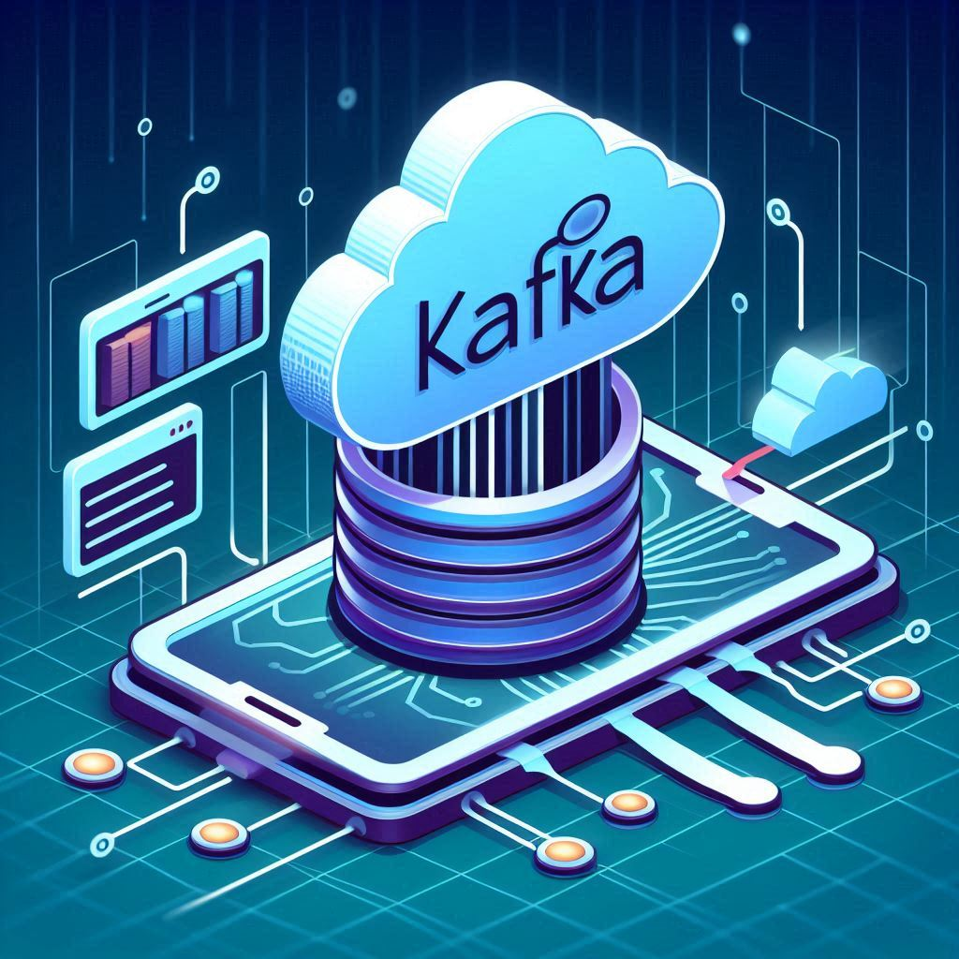
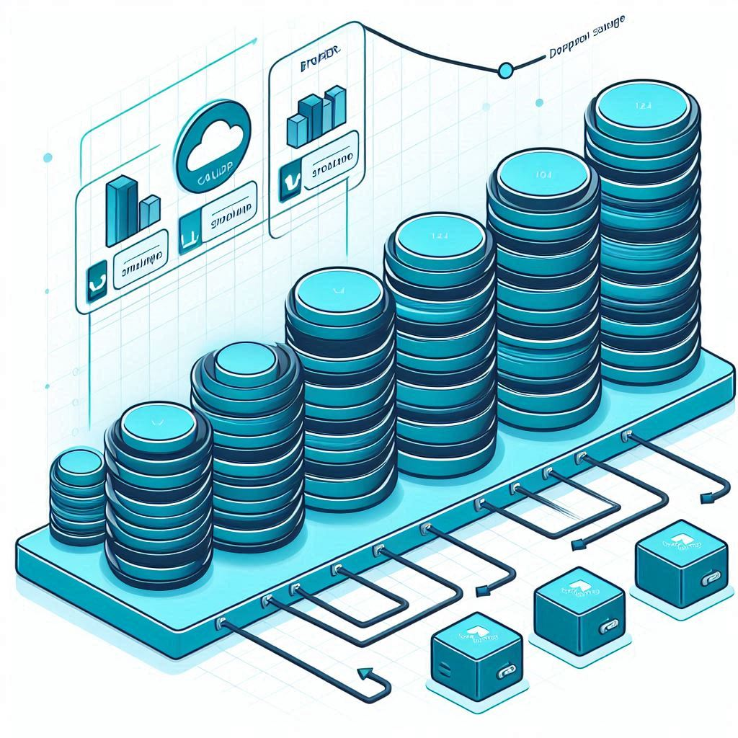


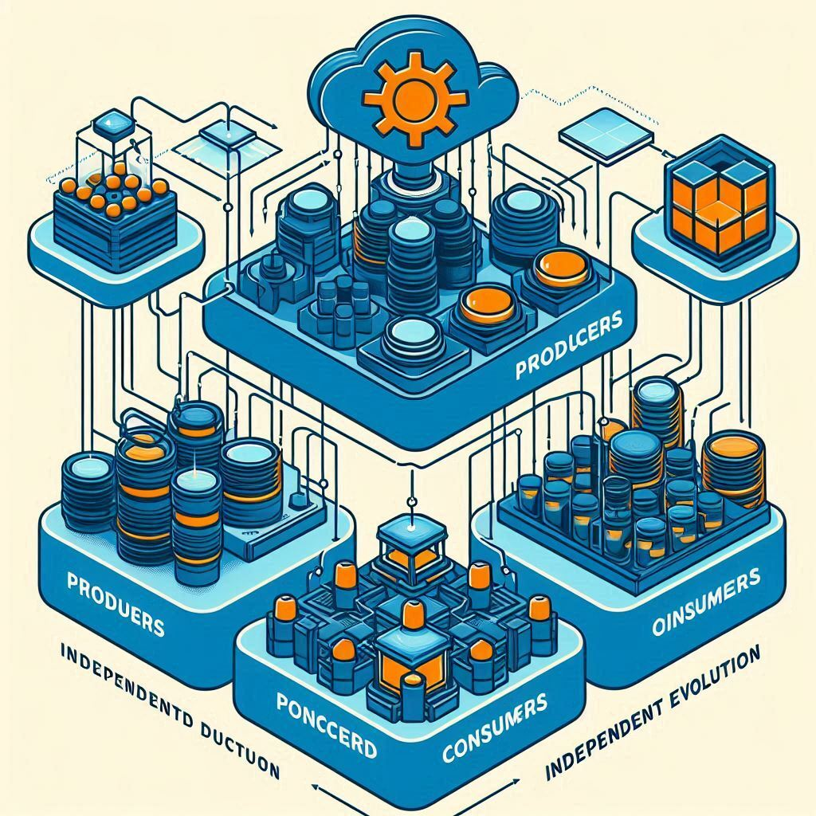
Why Kafka?
Real-Time Data Streaming
Scalability
Durability and Reliability
High Throughput
Decoupling
Fault Tolerance
Notes:
Real-Time Data Streaming:​
Kafka is ideal for applications that require immediate processing of data as it arrives.​
Scalability:​
Kafka is designed to handle large volumes of data and can easily scale horizontally by adding more brokers to a cluster.​
Durability and Reliability:​
Kafka ensures data durability and reliability through replication. Data is written to multiple brokers, ensuring no data loss even if a broker fails.​
High Throughput:​
It can handle high throughput of messages, making it suitable for use cases like log aggregation, metrics collection, and real-time analytics.​
Fault Tolerance:​
Kafka is designed to be fault-tolerant, with data replication and distributed architecture that ensures continuous operation even during hardware failures.​
Decoupling of Systems:​
Kafka decouples producers and consumers, allowing different parts of a system to evolve independently. This is particularly useful in microservices architectures.​

Slide 6
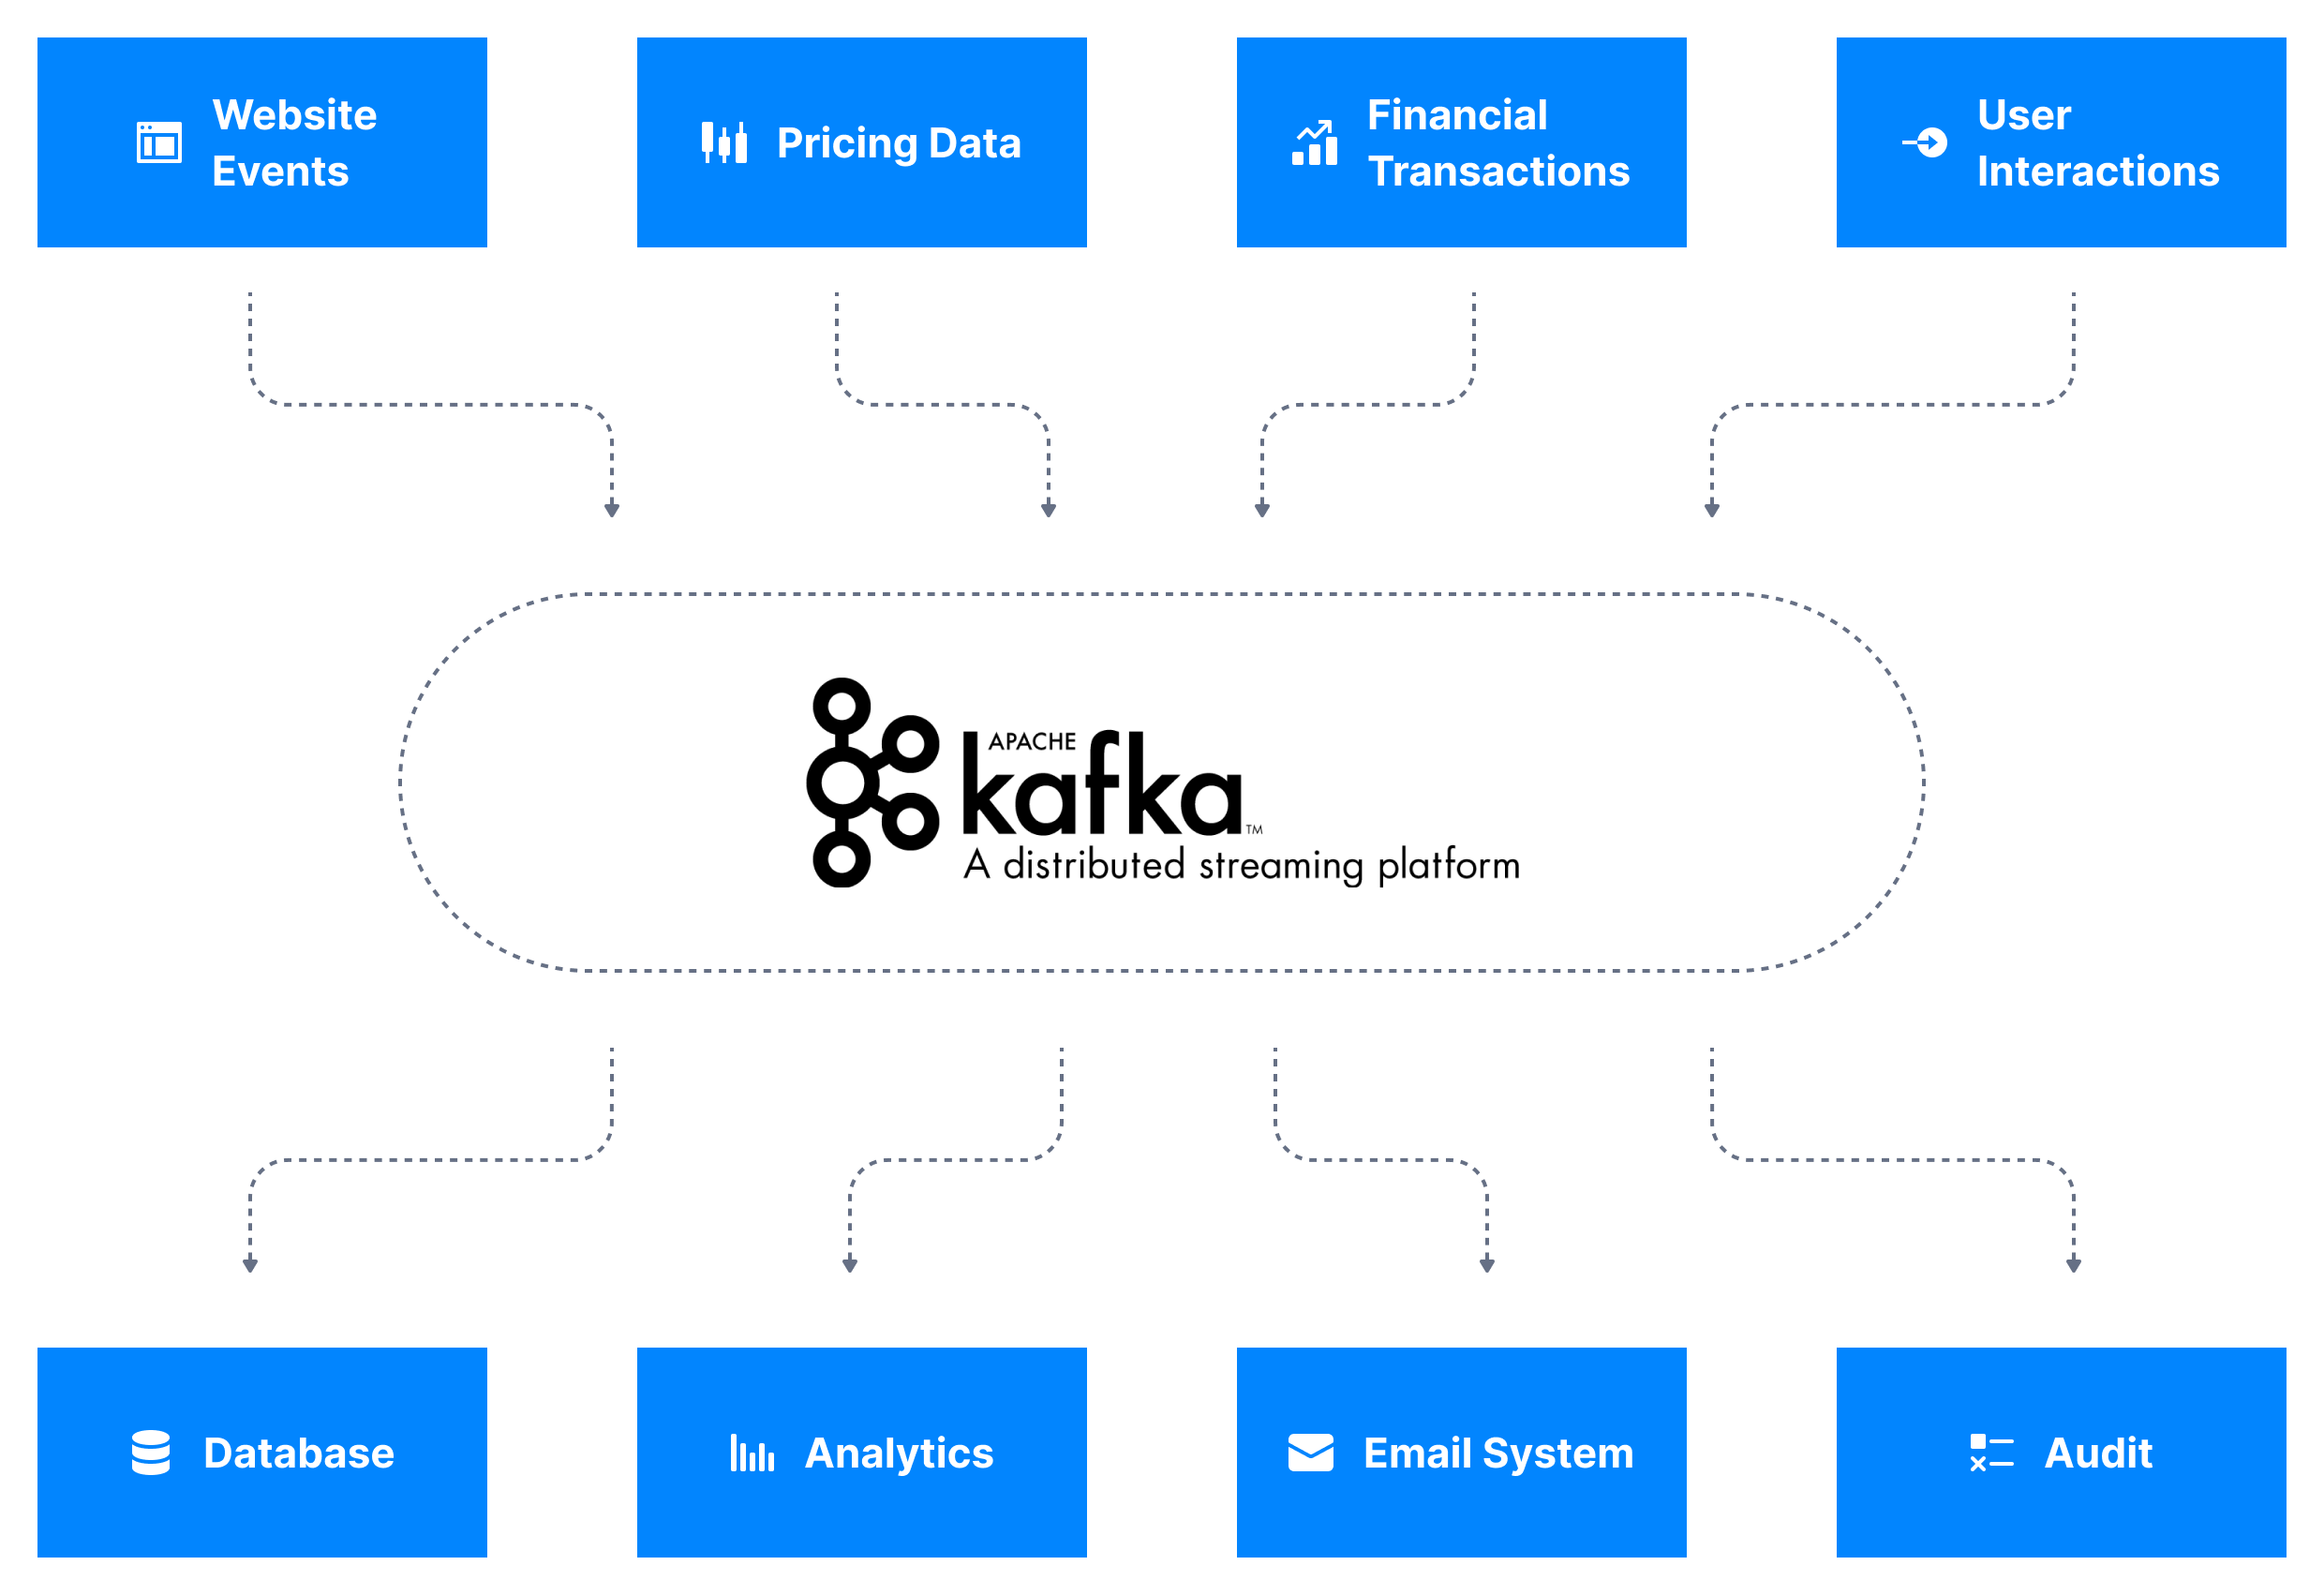
Use cases
Stream Processing
Log Aggregation
Integration with Big Data Technologies
Enterprise Use Cases
Notes:
Stream Processing:​
Kafka is a core component for stream processing platforms. It allows the processing of continuous streams of data in real-time.​
Event Sourcing:​
Kafka is widely used for event sourcing, where state changes in an application are logged as a series of events. This helps in rebuilding the application state and provides a reliable audit log.​
Log Aggregation:​
Kafka is often used for log aggregation, where logs from multiple services are centralized in a single place for analysis and monitoring.​
Integration with Big Data Technologies:​
Kafka integrates seamlessly with big data technologies like Hadoop, Spark, and Flink, enabling powerful data processing and analytics pipelines.​
Enterprise Use Cases:​
Kafka is used by enterprises for various use cases including tracking user activity, monitoring systems, processing payments, and more.​

Slide 7
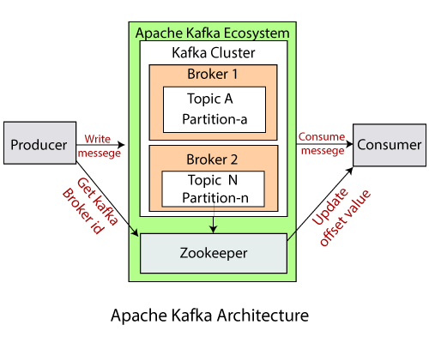
Architecture
Producers
Consumers
Topics
Brokers
Partitions
Zookeeper
Notes:
Producers:
Applications that send data (messages) to Kafka topics.
Consumers:
Applications that read data from Kafka topics.
Topics:
Named channels to which producers send messages and from which consumers read messages.
Brokers:
Kafka servers that store and serve data. A Kafka cluster consists of multiple brokers.
Partitions:
Topics are divided into partitions, allowing for parallel processing and scalability.
Zookeeper:
Kafka uses Zookeeper for distributed configuration management and coordination.

Slide 8

Pros & Cons
Advantages
Community-Driven
Flexibility
Cost
Limitations
Management Complexity
Limited Built-In Tools
Notes:
Advantages
Community-Driven: Being open-source, it benefits from community contributions and wide adoption.
Flexibility: Users can extend and customize Kafka to fit their specific needs.
Cost: Free to use under the Apache license.
Limitations:
Management Complexity: Requires significant expertise to deploy, configure, and manage at scale.
Limited Built-In Tools: Lacks comprehensive out-of-the-box tools for monitoring, security, and stream processing.

Slide 9
Flavors of Kafka
Kafka Type | Managed By | Key Features | Use Case
Apache Kafka | Apache Software Foundation | Core Kafka components, open-source | General-purpose, customizable
Confluent Kafka | Confluent Inc. | Schema Registry, KSQL, Control Center, enterprise features | Enterprise, enhanced features
Amazon MSK | AWS | Fully managed, integrated with AWS services | AWS cloud environments
Azure Event Hubs for Apache Kafka | Microsoft Azure | Managed, integrates with Azure ecosystem | Azure cloud environments
Google Cloud Pub/Sub Lite | Google Cloud | Managed, scalable, reliable | Google Cloud environments
Strimzi | Community | Kubernetes-native Kafka | Kubernetes deployments
Redpanda | Vectorized | Kafka API-compatible, high performance | High-performance streaming
IBM Event Streams | IBM | Managed, enterprise-grade features | IBM Cloud environments

Slide 10
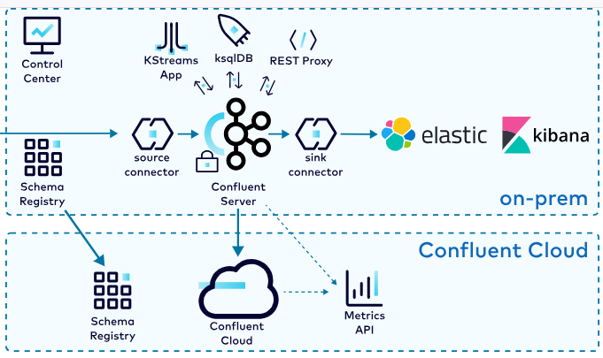
Confluent Kafka
Confluent Kafka is an enhanced, enterprise-ready distribution of Apache Kafka developed by Confluent Inc., a company founded by the original creators of Kafka.
Notes:
Builds on the open-source Apache Kafka by providing additional tools, features, and services that make it easier to use, manage, and integrate Kafka in enterprise environments.

Slide 11
Apache Kafka vs Confluent Kafka
Feature | Apache Kafka | Confluent Kafka
License | Apache 2.0 | Commercial (with open-source core)
Core Functionality | Core Kafka components | Core Kafka + enhanced features
Schema Management | No built-in Schema Registry | Schema Registry included
Stream Processing | Limited to Kafka Streams API | KSQL + Kafka Streams API
Monitoring and Management | Requires third-party tools | Confluent Control Center
Integration | Limited built-in connectors | Extensive pre-built connectors
Security | Basic security features | Advanced security features
Support | Community support | Professional support from Confluent
Ease of Use | Requires expertise | User-friendly tools and interfaces

Slide 12
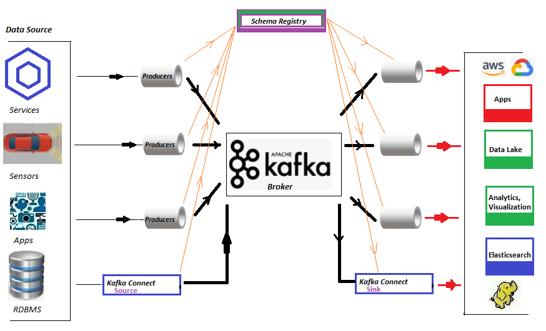
Confluent Kafka
Key Features
Schema Registry
KSQL
Confluent Control Center
Security Features
Connectors
Streams API and Kafka Streams
Multi-Cluster and Multi-Region Support
Notes:
Schema Registry: Manages and enforces data schemas, ensuring data compatibility and evolution.
KSQL: A SQL-like language for real-time stream processing, allowing users to query and manipulate data streams.
Confluent Control Center: A web-based interface for monitoring, managing, and administering Kafka clusters.
REST Proxy: Allows HTTP-based interaction with Kafka, simplifying integration with web-based applications.
Security Features: Enhanced security with role-based access control (RBAC), encryption, and end-to-end security.
Connectors: A wide range of pre-built connectors for integrating Kafka with various data sources and sinks.
Streams API and Kafka Streams: Libraries for building stream processing applications.
Multi-Cluster and Multi-Region Support: Supports geo-replication and disaster recovery.

Slide 13
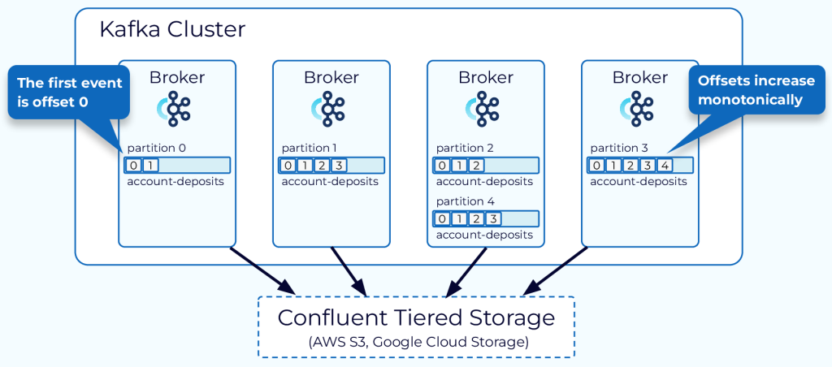
Confluent Kafka
Offset
Notes:
An offset is a unique identifier assigned to each message within a partition.
increments sequentially as new messages are produced to the partition.
Plays a critical role in Kafka's ability to ensure reliable message processing, as they enable consumers to keep track of which messages they have processed and which they have not.
Producer Perspective:
When a producer sends a message to Kafka, the broker appends the message to the specified partition and assigns it the next available offset.
Consumer Perspective:
Consumers read messages from Kafka topics by specifying the partition and offset from which to start reading.
Each consumer keeps track of the offset of the last message it has processed.

Slide 14
Demo
https://github.com/tarunpoddar

Slide 15
Thank you

